Slide 1
GENPL (Gender Equality Network for Progress)
Garima, Nicole, Paola, Lucie
Week3_Team_1

Slide 2

Outline
Project Overview
Data Wrangling and Cleaning
Exploratory Data Analysis
Teamwork & Project Management
Major Obstacle
Conclusion
Summary
Links

Slide 3
Business Idea
"Driving GDP Growth Through Gender Equality"
Our services:
Workforce Analysis: Identify and address gender disparities in organizations.
Policy Development: Create policies that enhance gender equality.
Economic Impact Studies: Showcase the economic benefits of gender equality.
Advocacy Campaigns: Drive awareness and influence policy for gender equality.
Notes:
We are a consulting and advocacy firm dedicated to enhancing economic growth by tackling gender inequality in the workforce. We partner with governments, businesses, and NGOs to design and implement strategies that promote gender equity, ensuring that women have equal opportunities to contribute to the economy. By closing the gender gap in employment, leadership, and pay, we help countries unlock their full economic potential, driving significant GDP growth.

Slide 4
Project Overview – The Process
Can we add Trello screenshot?
Add link
We randomly picked 12 countries with a mix of GDP’s covering these areas:
Region | Europe | Americas | Asia Pacific | Africa
Countries | Norway | United States | Japan | Ghana
 | Greece | Brazil | New Zealand | Cameroon
 | France | Colombia | Pakistan
 | Germany

Slide 6
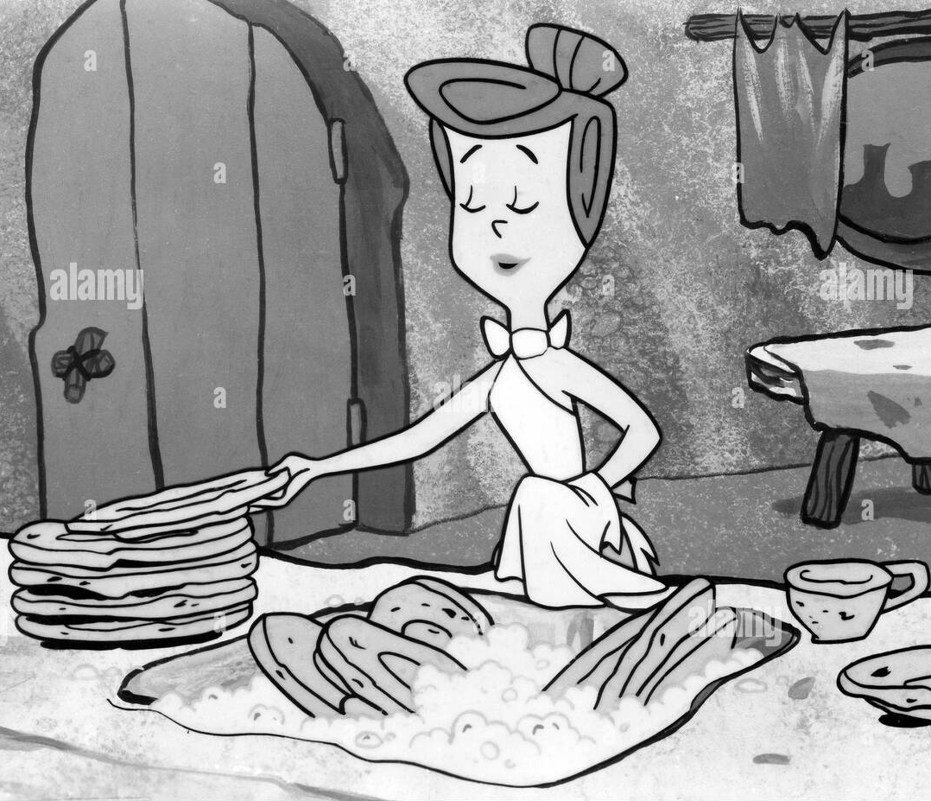
Hypothesis - Primary
“If women shift time from unpaid domestic work to paid employment, GDP will rise.”
Data Sets to Support:
Will add links or logos of the website

Slide 7
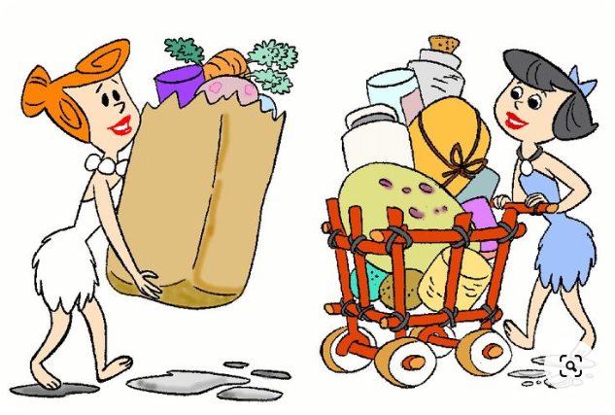
Hypothesis - Secondary
“Implementing and enforcing equal pay policies will reduce the gender pay gap.”
Increased household income will drive GDP growth.
Higher disposable income will boost consumption, stimulating economic demand.
Greater investment in education and health will enhance long-term workforce productivity.

Slide 8
Our Findings & Analysis
If the participation of women work force increases, then the GDP will increase.
Graphs to show that the correlation in 1 ---- has strong impact

Slide 11
Major Obstacle

Slide 17



Summary
Highlight the 3 main graphs that support our hypothesis

Slide 18




Thank you
Presenter name
Email address
Website

